Slide 1

Strategic Insight Slides - Draft
Auto & Operational Performance Trends
Prepared by: Yutong Wang
Date: 2026.7.18
www.oliver-wyman.com

Slide 2
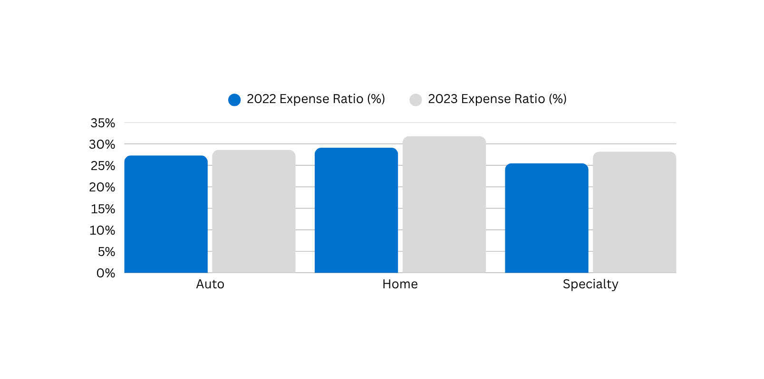

Overhead & Expense Ratios
Cont. to Rise
Home and Specialty lines show highest growth in non-claims expenses
IT and personnel costs identified as primary drivers from internal commentary
Sofia contributed this analysis to provide financial context on cost pressure.

Slide 3
Auto Loss Ratio Rose 6pts YoY
[Auto’s underperformance driven by loss ration spike and declined market share]
Loss ratio increased by 6 pts, which exceeds the market average
Market share declined despite flat pricing

Slide 4
Auto overall performance
Hypothesis 1: Performance erosion is likely due to inappropriate risk selection without corresponding change in pricing
Hypothesis 2: Claims processing delays may be inflating incurred losses beyond projections

Slide 5

Next Steps
Internal Alignment: What to Explore
Deep dive on underwriting segmentation in Auto
Explore pricing consistency across high-loss states
Flag anomalies for stakeholder interviews
Final Note: Draft slides intended for internal discussion only. Subject to revision based on team input.

